Slide 1
Auto Delivery Capstone
Douglas Lindsey
August 18th, 2022

Slide 2

About Me…
B.A. in Philosophy from Virginia Tech
B.S. in Engineering from Embry-Riddle Aeronautical University
M.P.S in Psychology of Leadership from Penn State
Currently working on M.S. in Aerospace Engineering from Embry-Riddle Aeronautical University
U.S. Army Infantry Veteran
Looking for a career shift to Data Analyst/Data Scientist Role
Hoping to work in Defense/Aerospace industry
Avid Virginia Tech football fan (Go Hokies!), hoping we don't get left out of the ongoing college realignment

Slide 3
Capstone Goal and Hypothesis
Goal – Apply taught data analysis techniques to a hypothesis to familiarize and build confidence in myself working with SQL and Power BI/Power Query to answer my hypothesis.
Hypothesis – Ports with heavier traffic would have a larger share of dwell time (amount of time between arriving and a port and sailing from it).

Slide 4
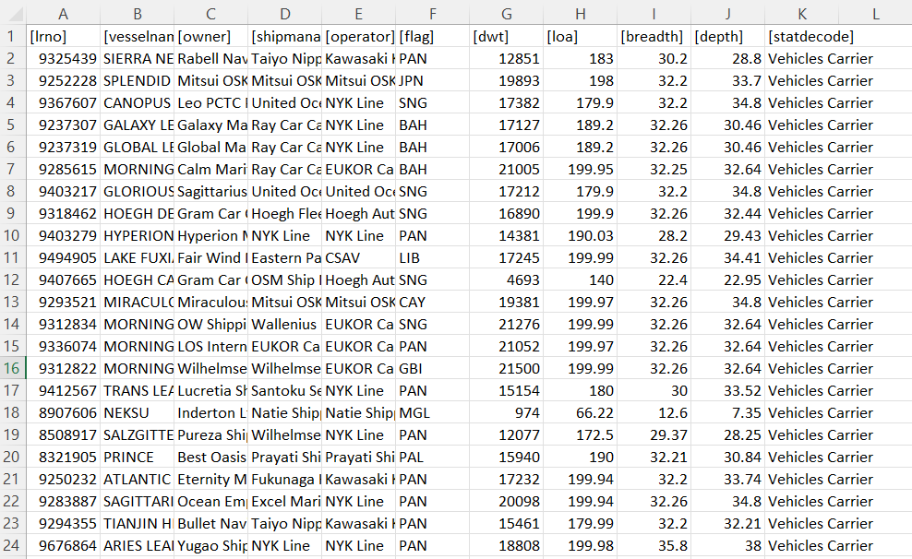
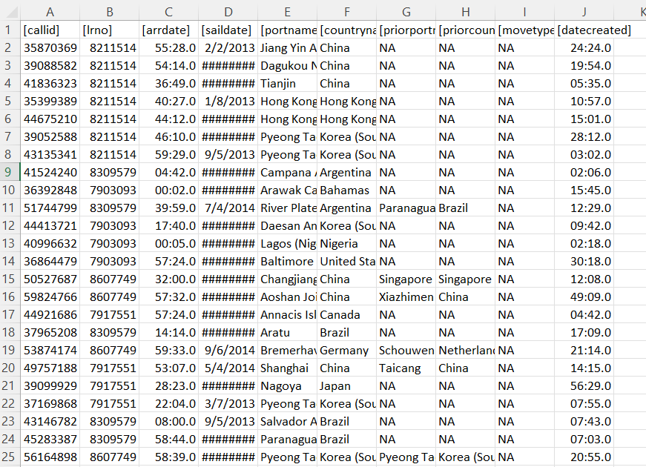
Data Familiarization
Initial Data Given
Ships Calls

Slide 5
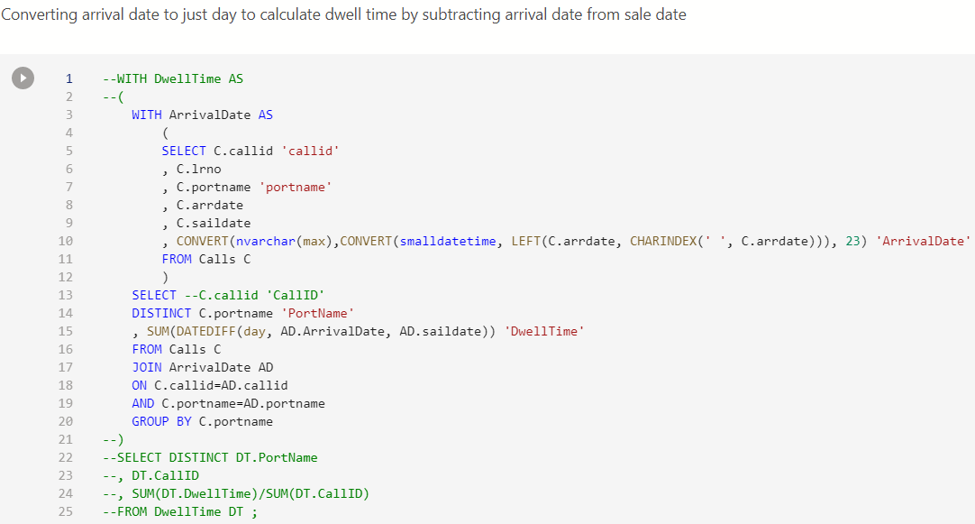
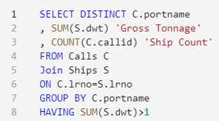
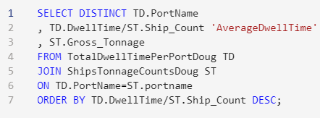
SQL Work
Made a Jupyter Notebook to figure out dwell time per call, average dwell time per port, gross tonnage per port, total ship count per port, and total dwell time per port

Slide 6
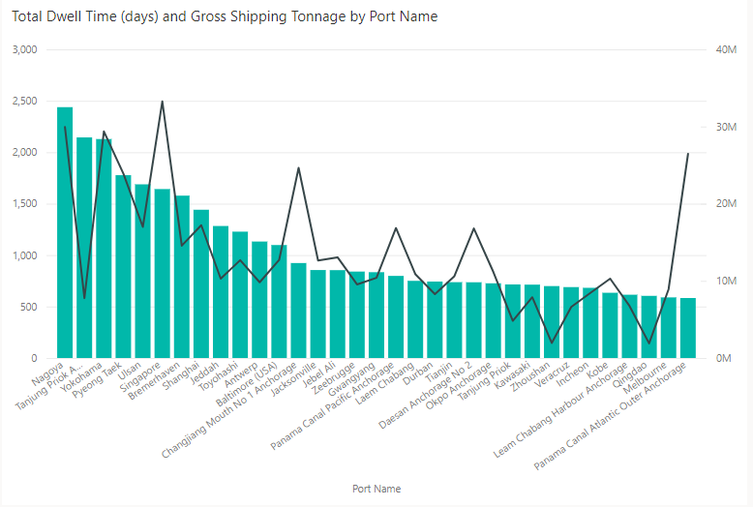
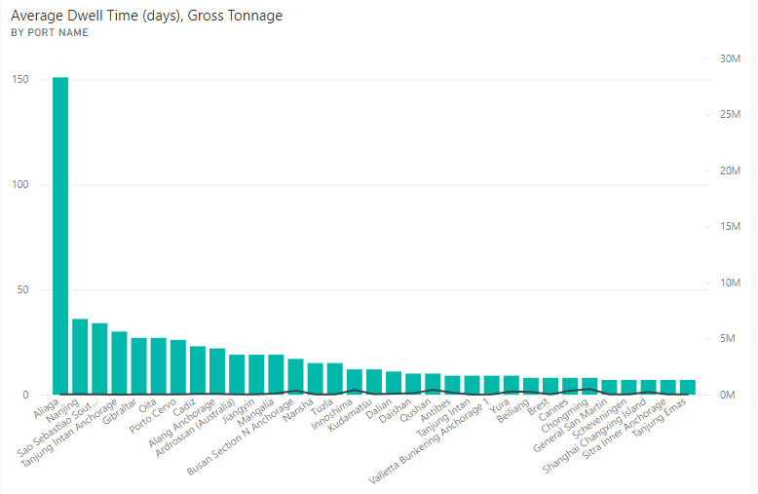
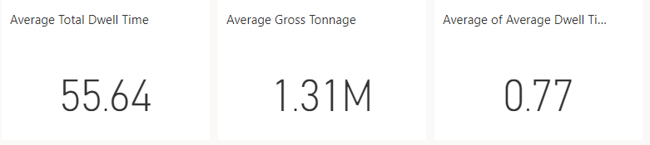
Power BI Work
I imported the initial data as well as the SQL results as flat files into Power BI and did a little cleaning with Power Query but did not need to build any new tables or measures. I then built my visuals with Power BI and put the results in a dashboard.

Slide 7
Capstone Conclusion
From the results we can see that the total dwell time per port is generally correlated to the gross tonnage that the port gets (as would be expected), however the average dwell time is not correlated to the gross tonnage at all.
This is to say that the busiest ports do not have the greatest delays.
Therefore, my hypothesis was wrong.

Slide 8
Where To Go Next
Having shown that the busiest ports are not the slowest it would then behoove planners to target ports that were not high on my average dwell time list when route planning.
The next steps with the data set would be to figure out the standard routes of the auto carriers and then see if certain lines/management companies/owners are slower and use this information to inform who to hire to crew/manage 'our' auto carriers.
Following this step, it would then should be possible to predict where ships are going based upon where they have been and use this to predict rival company's ship movements.

Slide 9
Lessons Learned
The biggest lesson learned is that figuring out what you want to ask is crucial, even more so than data familiarization.
Additionally, time management is crucial as you have to find an answer within the given time, 'a day late and a dollar short' does not cut it.

Slide 10
Questions

Slide 11
Acknowledgements
I would like to thank Divergence Academy, Drew Minkin, and Rachel Ridenour for getting me to the point where I can do this, admittedly basic, level of data analysis and visualization.

